Slide 1
Event Portfolio Management
Instructor’s Manual:

Slide 2
Figure 1: A framework for understanding and creating knowledge about planned events.

Slide 3
Figure 2: Roles of events as instruments of policy and strategy.
EVENTS and PORTFOLIOS
PLACE MARKETING: Co-branding events with destination
CULTURAL -Arts and cultural development -Preserve authentic traditions
ENVIRONMENT
-Heritage and nature conservation -Urban renewal -Environmental education through events
TOURISM
SOCIAL -Foster social interaction -Improve quality of life -Capacity-building for community development
Image Maker: Create positive image of destination
Animator: Of venues, spaces, resorts, cities
Catalyst: For new infrastructure and increased tourism capacity
Attraction: -High-yield event tourists -All year round -Geographic spread

Slide 4
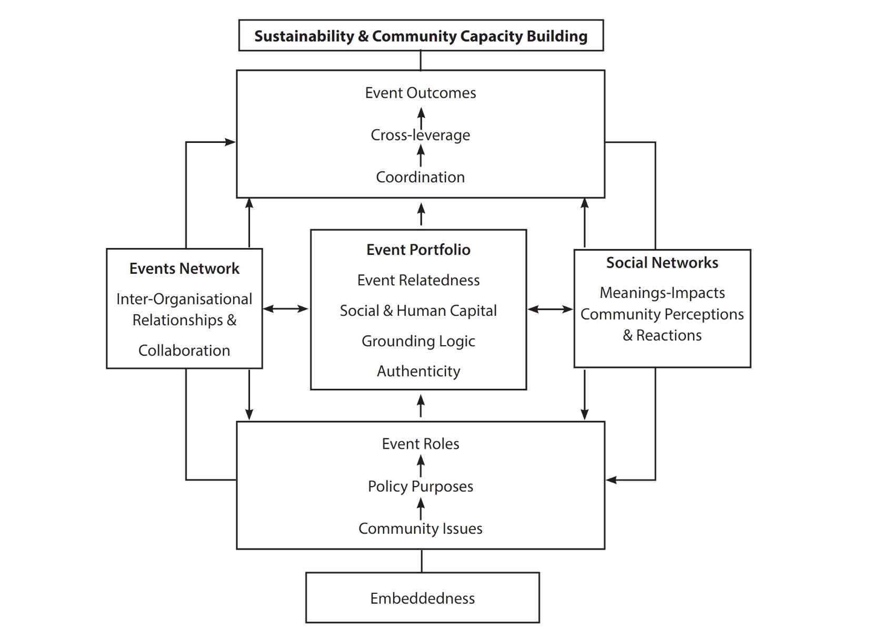
Figure 3: A comprehensive research framework for studying event portfolios.

Slide 5
Figure 4: The event strategy master plan.
Event Strategic Planning & Management
Event Staging & Implementation
Event
Leveraging

Slide 6
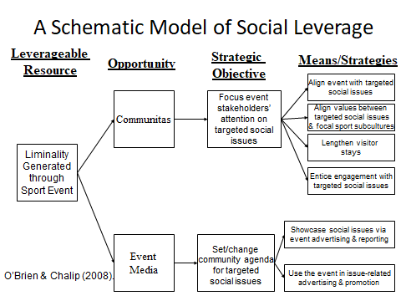
Figure 5: Social leverage of events.

Slide 7
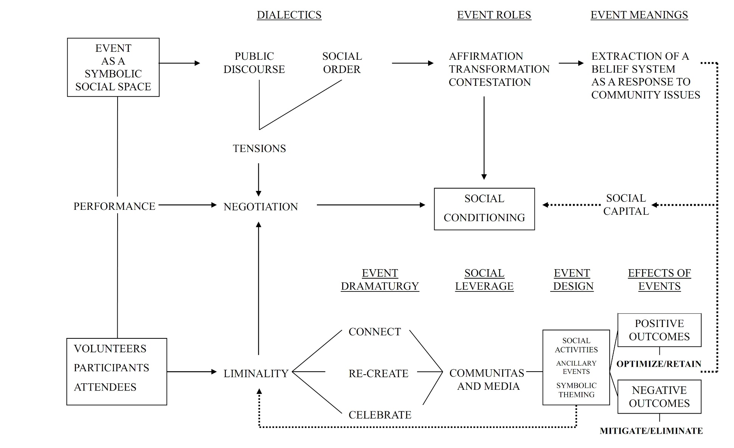
Figure 6: An integrated framework for understanding the social utility processes and outcomes of sport and cultural events.

Slide 8
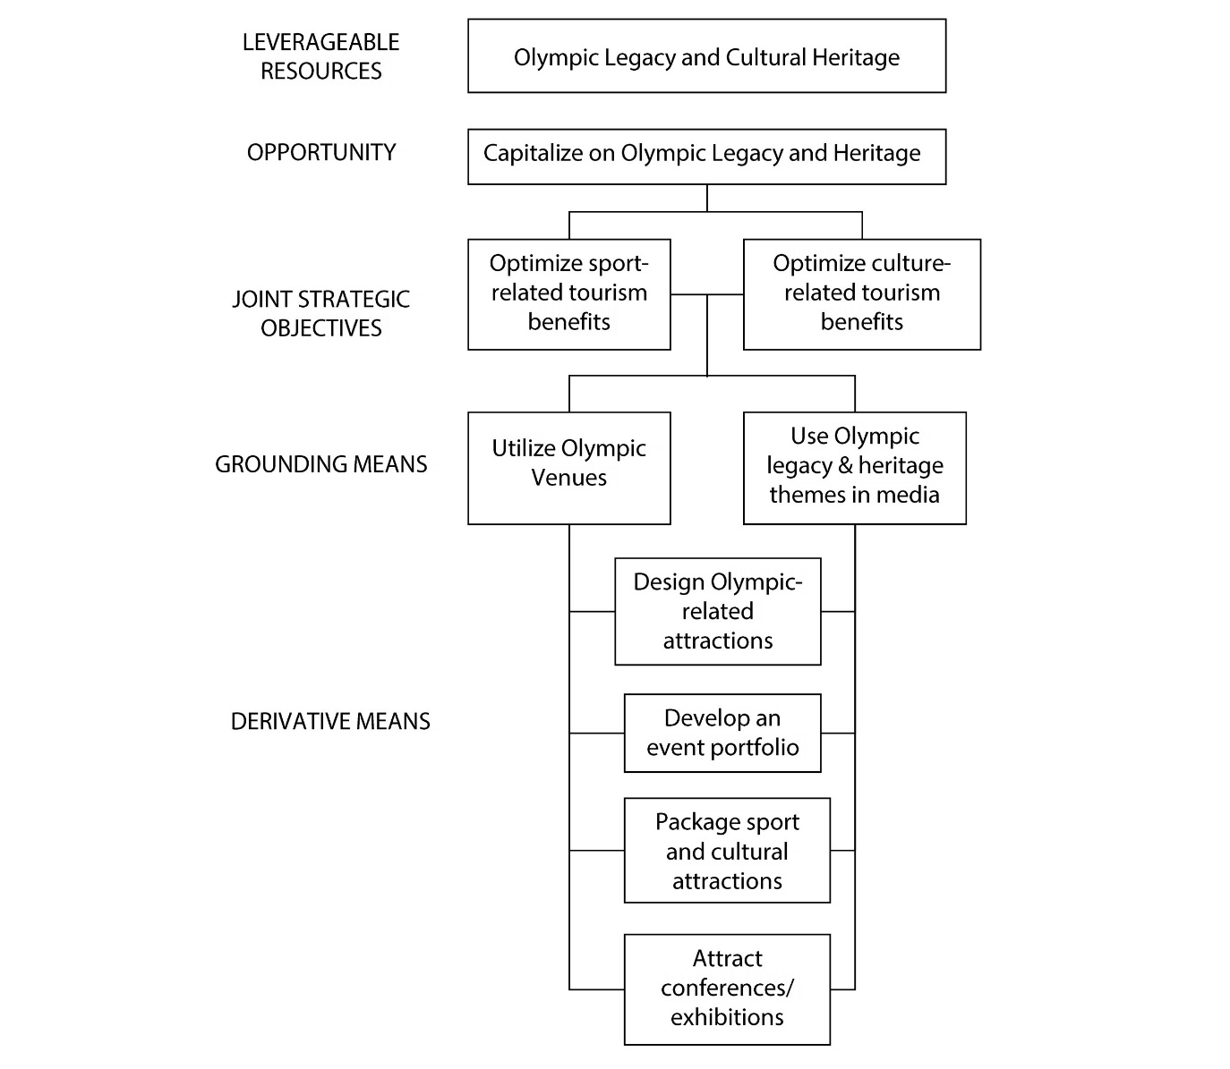
Figure 7: A strategic planning framework for leveraging post-Games Olympic tourism.

Slide 9
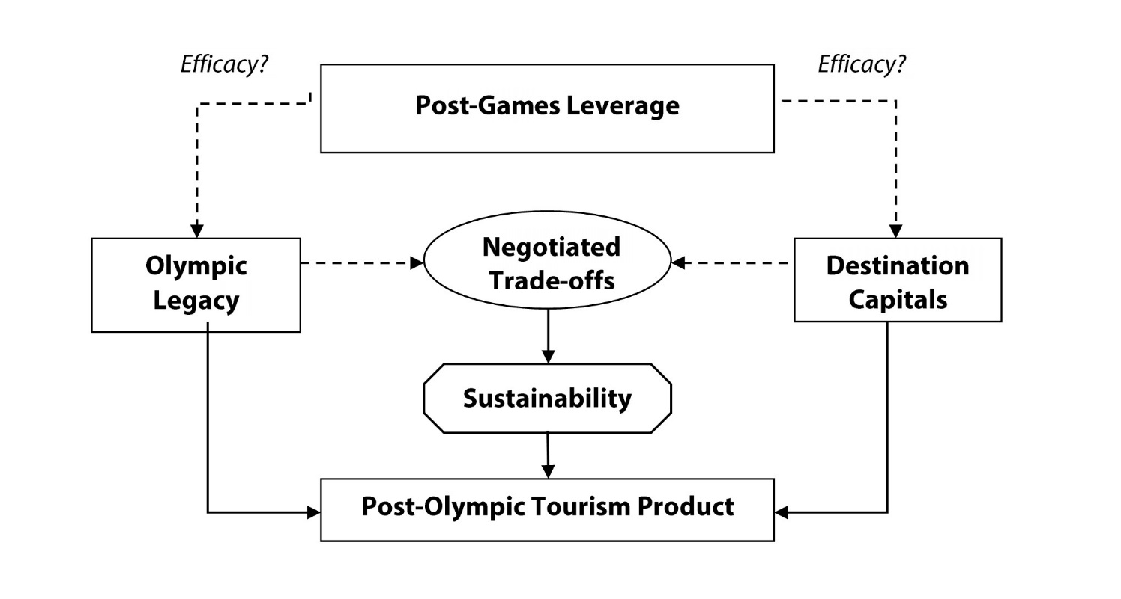
Figure 8: Post-event leverage for creating sustainable post-Olympic tourism products.

Slide 10
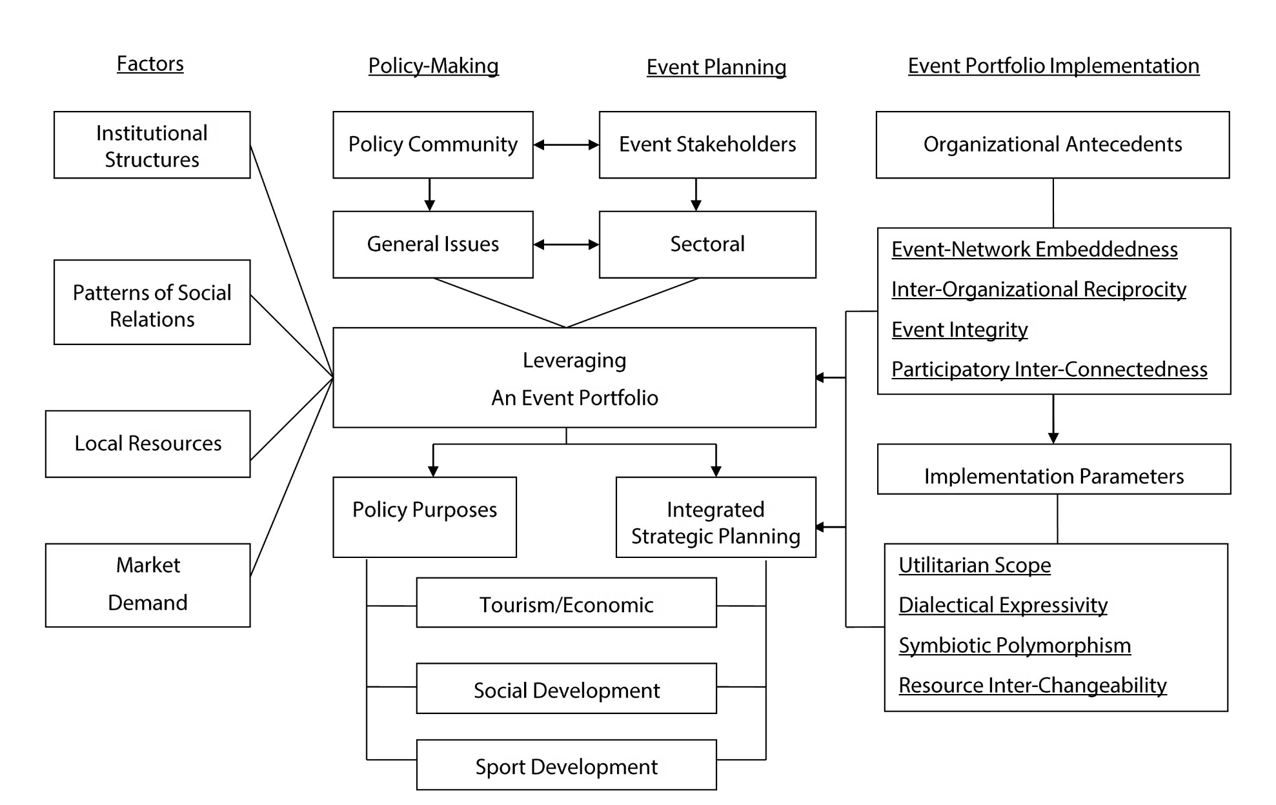
Figure 9: Event portfolio planning and leveraging.

Slide 11
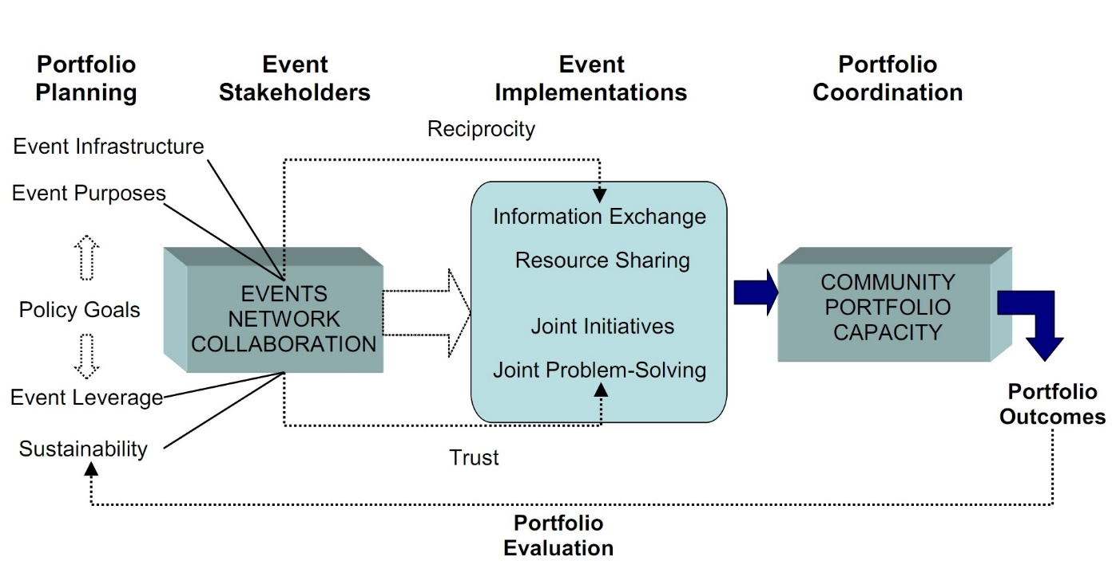
Figure 10: Events network and community portfolio capacity.

Slide 12
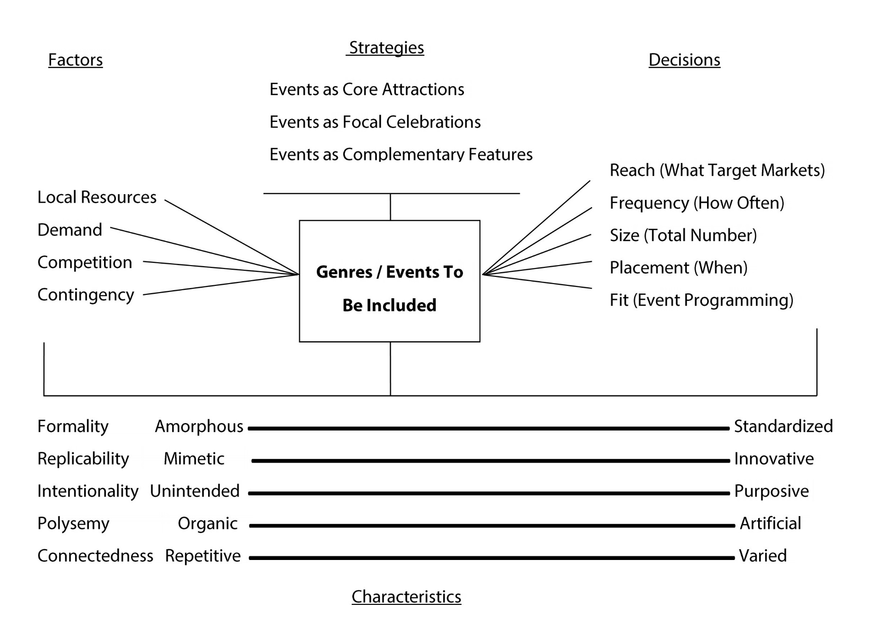
Figure 11: Event portfolio design.

Slide 13
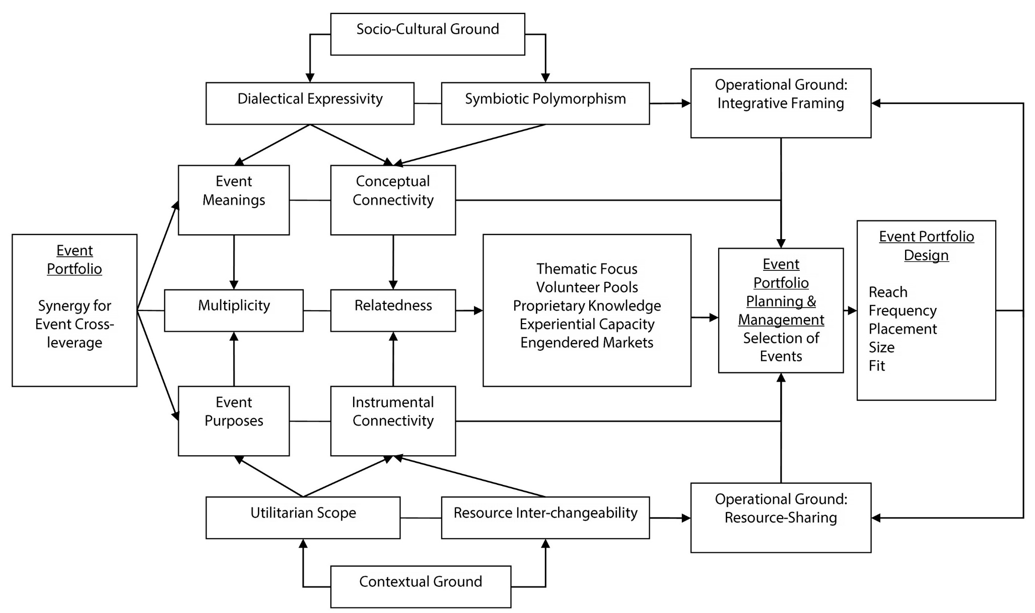
Figure 12: A multi-dimensional model of the synergistic dynamics in an event portfolio.

Slide 14
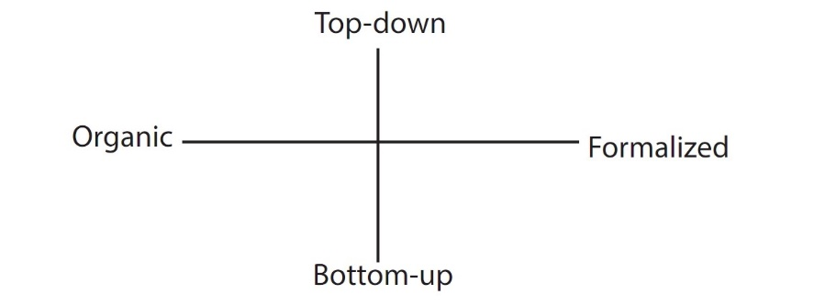
Figure 13: Event portfolio structure.

Slide 15
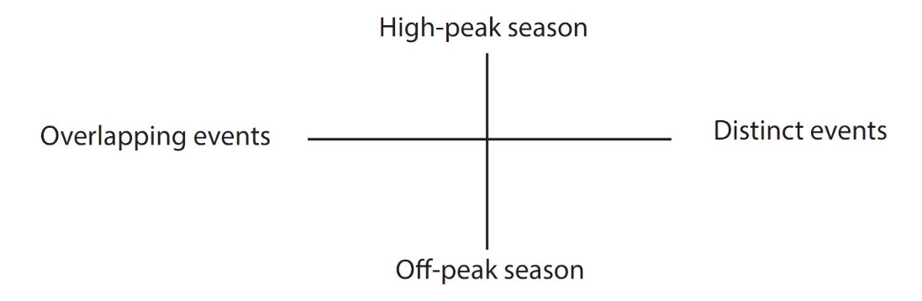
Figure 14: Event portfolio programme.

Slide 16
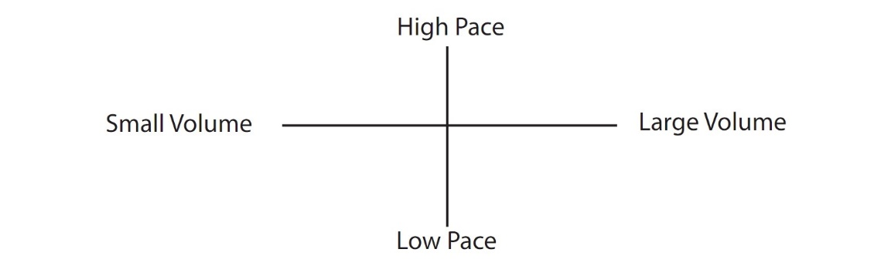
Figure 15: Event portfolio magnitude.

Slide 17
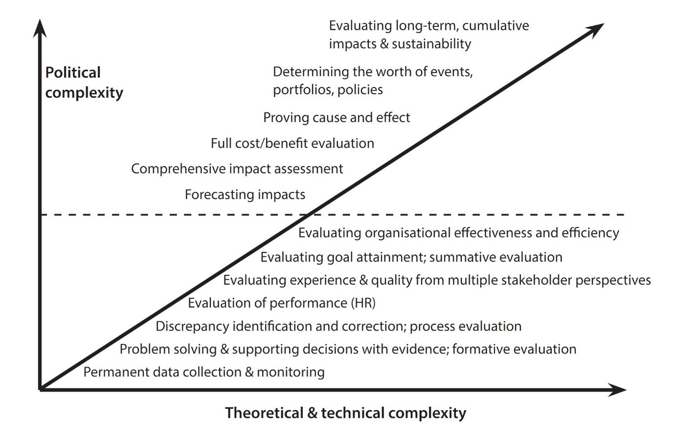
Figure 16: Evaluation complexity model.

Slide 18
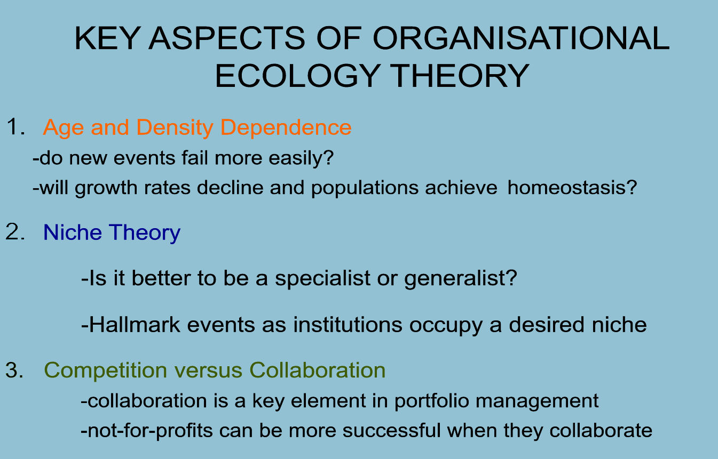
Figure 17: Key aspects of Organisational Ecology Theory (I)

Slide 19
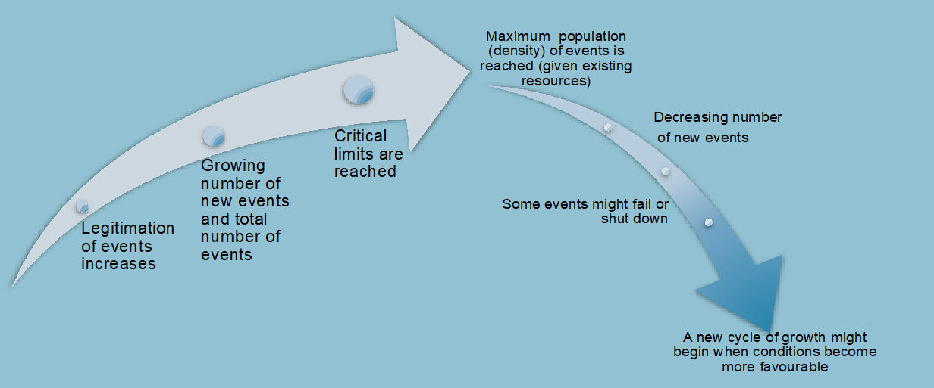
Figure 18: Key aspects of Organisational Ecology Theory (II)

Slide 20
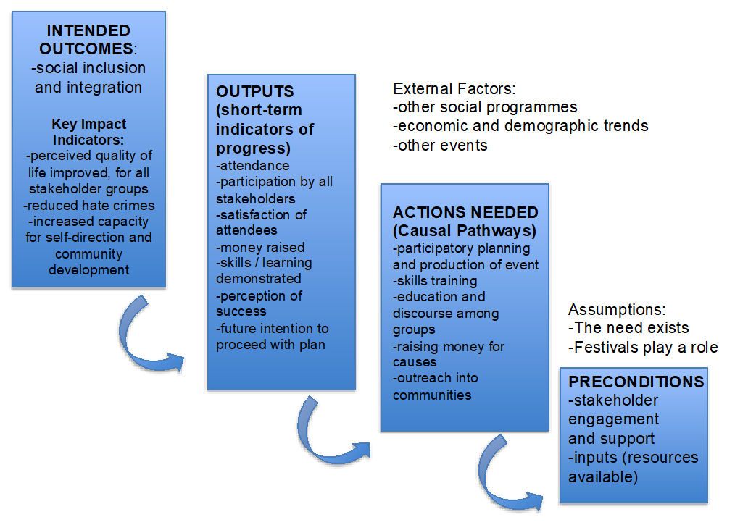
Figure 19: Theory of change model

Slide 21
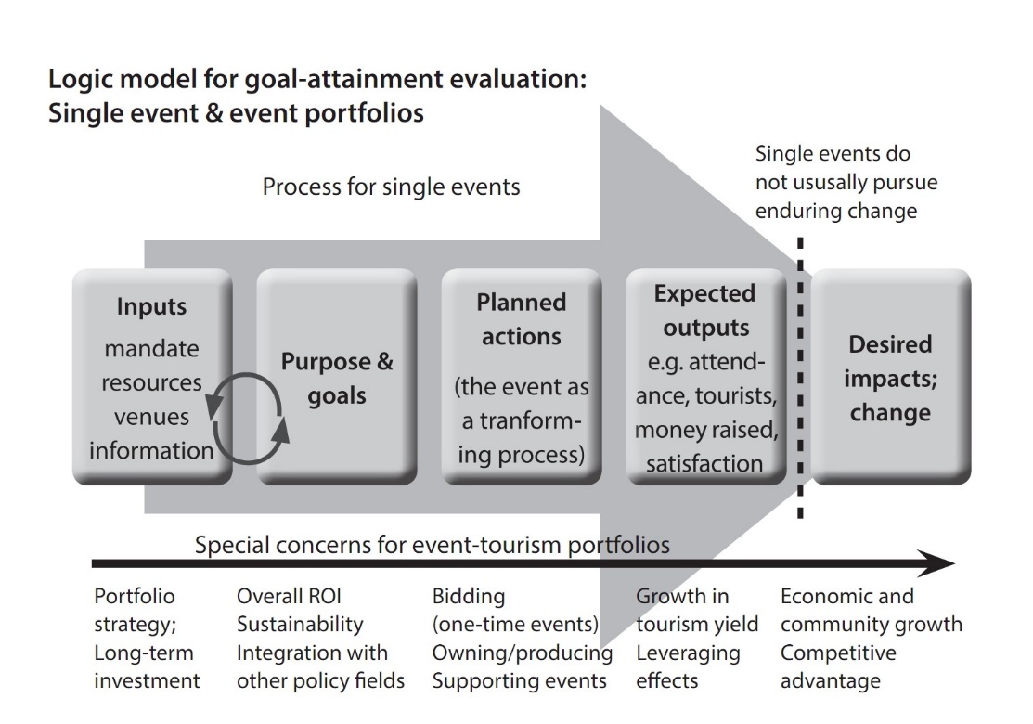
Figure 20: A logic model for event evaluation and impact assessment.

Slide 22
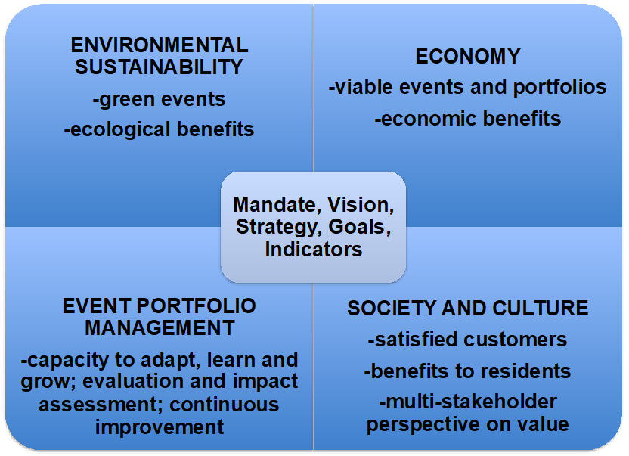
Figure 21: The Balanced Scorecard evaluation system

Slide 23
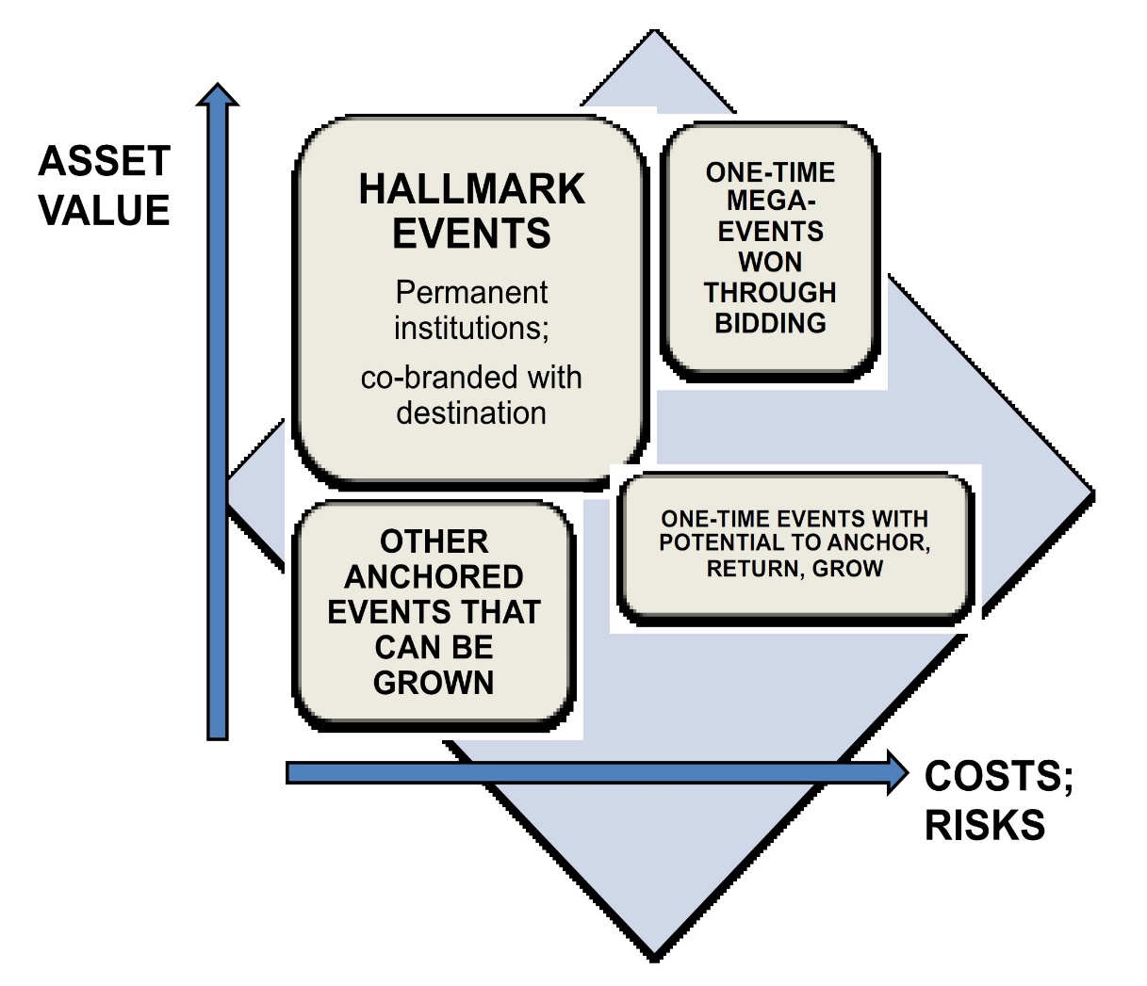
Figure 22: Matrix model

Slide 24
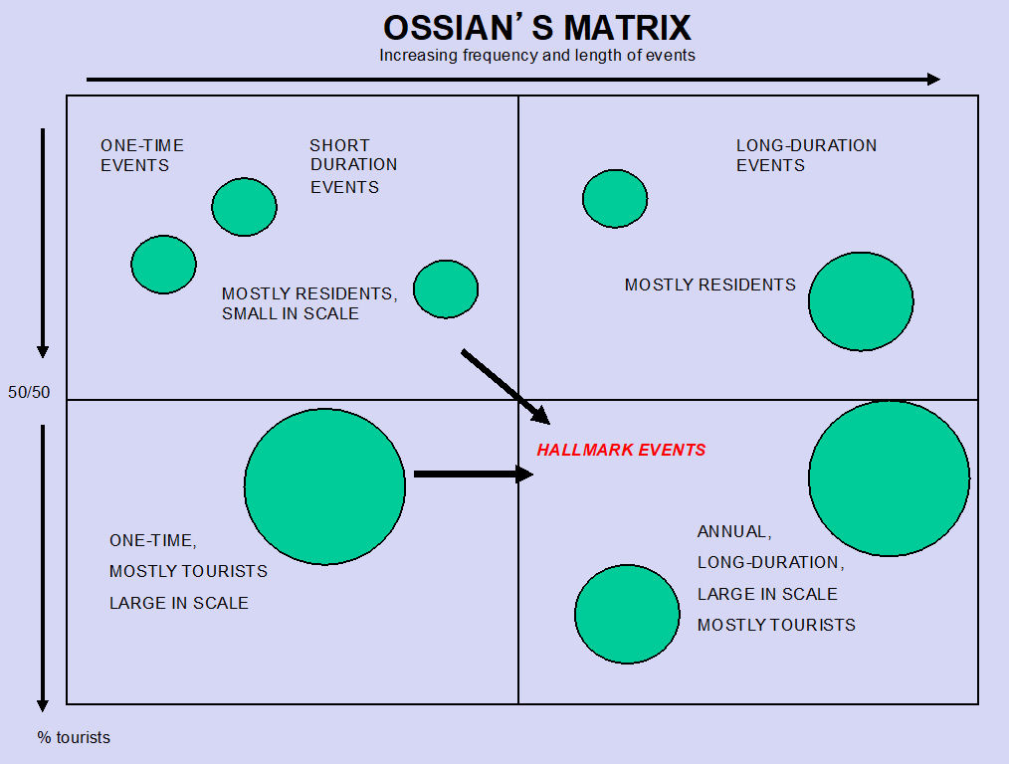
Figure 23: Ossian’s matrix

Slide 25
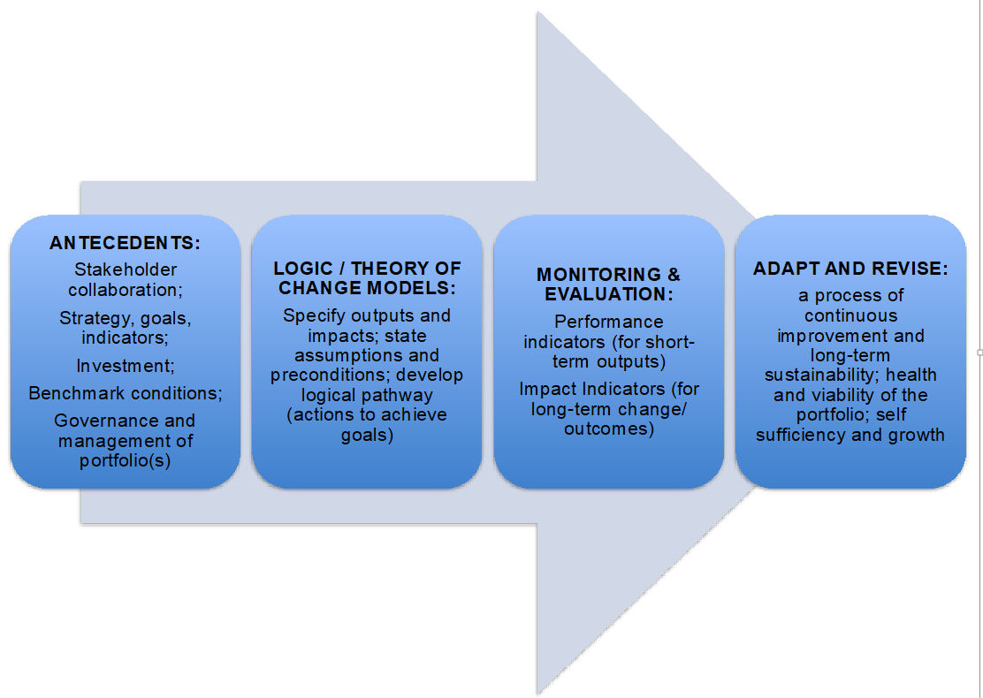
Figure 24: Process model

Slide 26
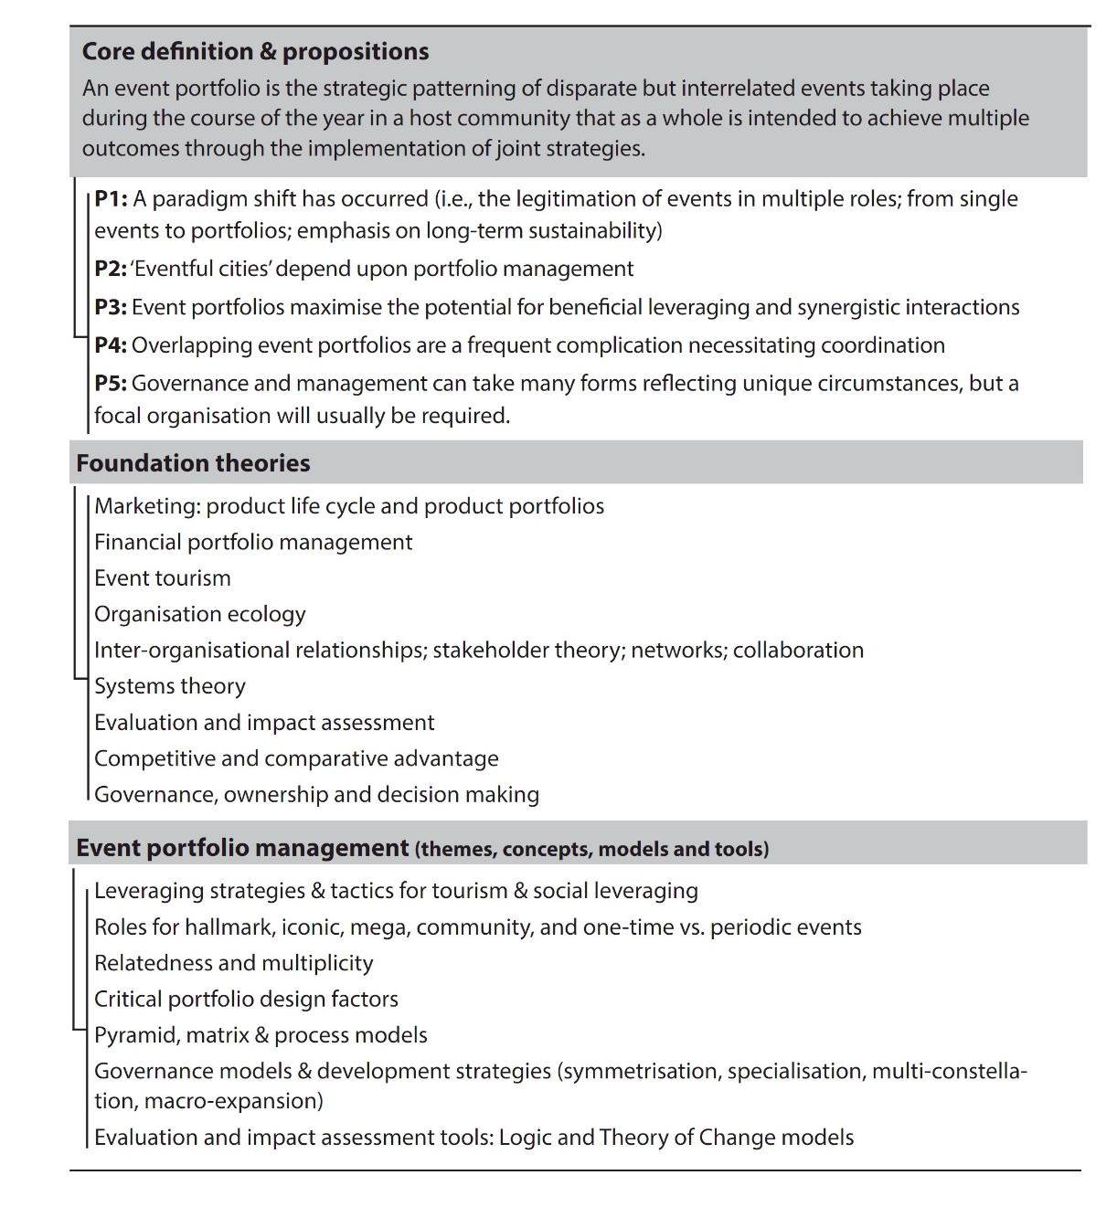
Figure 25: Ontological map of event portfolio studies

